Slide 1
UTSA CS 4593: CS-CURE
Course-based Undergraduate Research Experience in CS
Amanda Fernandez, Ph.D
UTSA Department of Computer Science
Spring 2024

Slide 2
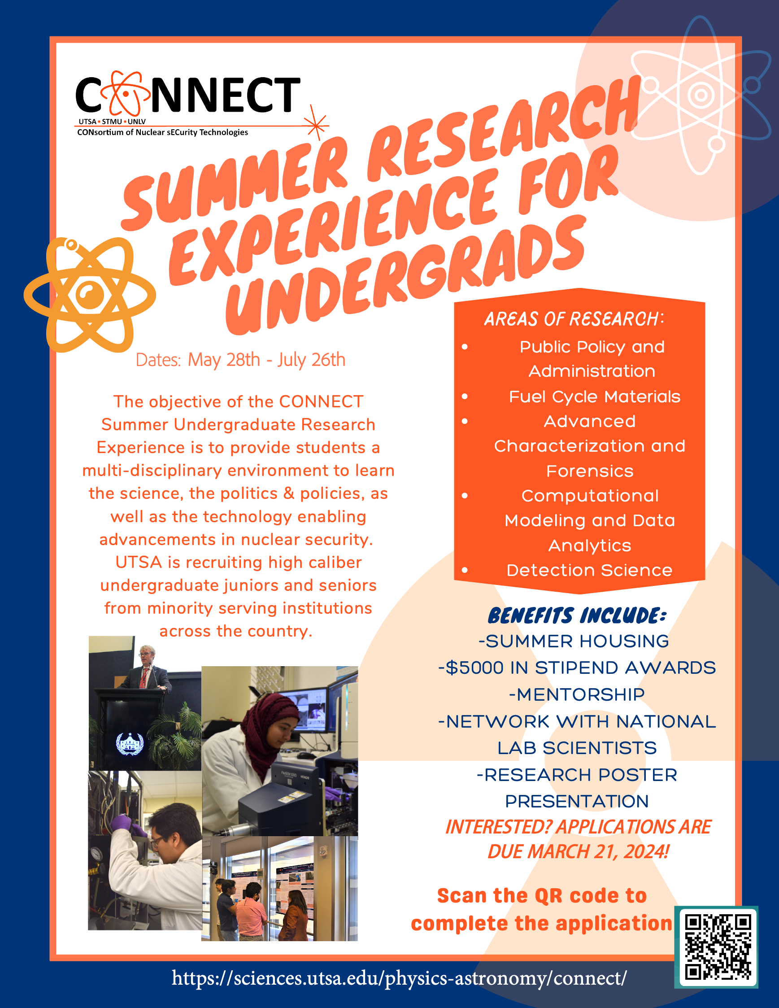

Slide 3
Week 6: Research Design

Slide 4
UTSA CS-CURE
Week 6
Objectives:
Formalize a research design for your project
Learn from expert(s) in diverse fields within CS
Deliverables:
Guest Lecture Survey (in-class Thursday)

Slide 5
Research Design
Creating a blueprint for your work

Slide 6
Computer Science Research
The next step in the process: research design
Research Design
Research Methodologies
a comprehensive plan
outlining the framework for conducting research
in order to answer
a specific research question
specific techniques & tools
used to collect, measure,
and analyze data
in a research project
This week!
In the coming weeks..

Slide 7
Computer Science Research
analogy: constructing a building
Research Design
Research Methodologies

Slide 8
Research Design
Fundamental components
Problem statement
Research questions
Methodology
Clearly defines the problem to be addressed.
Specific, answerable questions derived from the problem.
Strategies & tools you’ll use to answer the question(s).

Slide 9
Research Design
Rationale
Problem statement
Research questions
Methodology
Identifies the research gap and sets the stage for further exploration.
Focuses the research by guiding data collection, analysis, & interpretation,
Justifies the validity of your research work.

Slide 10
Research Design
Example
Problem statement
Research questions
Methodology
Recommender systems play a crucial role in various online platforms, but limited transparency can lead to user distrust and concerns about bias. This research aims to investigate the effectiveness of Explainable AI (XAI) techniques in enhancing trust in recommender systems.
Does increased understanding through XAI techniques lead to greater trust in the recommender system and user satisfaction?
What specific types of XAI explanations are most effective in different user contexts and for various recommendation tasks?
Surveys, experiments, and data analysis*
*research methodology to be expanded later

Slide 11
Research Design
Example types
The type of research design you choose depends on
your research questions,
available resources, & the
nature of your inquiry.
Each type offers distinct
advantages & limitations
Experimental
Observational
Case study
Survey

Slide 12
Experimental Design
A “benchmark” dataset is one defined by the research community as essentially a ‘standardized test’ for a specific task.
Research designs
Definition:
Tests hypotheses by manipulating variables & observing their effects.
Rationale:
Provides strong evidence for causal relationships.
Often used in algorithm evaluation & performance comparison.
Example:
Comparing different pre-processing techniques on a benchmark dataset to evaluate their impact on the accuracy of a machine learning task.

Slide 13
Observational Design
Research designs
Definition:
Analyzes existing data without manipulating variables
Rationale:
Useful for exploratory research, for understanding user behavior, and for identifying patterns in datasets.
Example:
Analyzing large-scale image datasets to identify common challenges & characteristics under certain conditions.

Slide 14
Case Study Design
Research designs
Definition:
In-depth investigation of a single individual, group, or phenomenon.
Rationale:
Provides rich insights into specific contexts.
Valuable for understanding complex systems & user experiences.
Example:
Studying the performance of new image recognition algorithm on a specific real-world application (e.g. autonomous driving).

Slide 15
Survey Design
Research designs
Definition:
Collects data from a large group of participants through questionnaires.
Rationale:
Identifies user attitudes, perceptions, & preferences.
Informs design decisions and system development.
Example:
Surveying users about their experiences with image recognition systems in certain autonomous driving conditions to understand their needs & preferences.

Slide 16
Research Lifecycle
Taking a step back to look at the overall process

Slide 17
Research Lifecycle
Research isn’t a single event!
Plan & design
Collect & create
Analyze & collaborate
Evaluate & archive
Share & disseminate
Publish & reuse
Repeat!
Image source: Harvard Biomedical Data Management

Slide 18
Research Lifecycle
..from the university research office perspective
Image source: Michigan Tech

Slide 19
Research Design
Getting started: proposal development
Ideas - identify a relevant & impactful problem within your area of interest
Literature Review - conduct a thorough review of existing research to understand & identify gaps
Proposal Development - clearly articulate your research question, methodology, expected outcomes, and potential contributions.

Slide 20

Research Design
The Heilmeier Catechism
DARPA operates on the principle that generating big rewards requires taking big risks. But how does the Agency determine what risks are worth taking?
George H. Heilmeier, a former DARPA director (1975-1977), crafted a set of questions known as the "Heilmeier Catechism" to help Agency officials think through and evaluate proposed research programs.
What are you trying to do? Articulate your objectives using absolutely no jargon.
How is it done today, and what are the limits of current practice?
What is new in your approach and why do you think it will be successful?
Who cares? If you are successful, what difference will it make?
What are the risks?
How much will it cost?
How long will it take?
What are the mid-term and final “exams” to check for success?
https://www.darpa.mil/work-with-us/heilmeier-catechism

Slide 21
Research Lifecycle
Execution & analysis
Execution - implement your chosen methodology
Data analysis - apply appropriate statistical techniques & visualizations to extract meaningful insights from the data
Critical evaluation - assess the limitations & potential biases of your research design & the findings.

Slide 22
Research Lifecycle
Dissemination & impact
Publication - share your research findings through peer-reviewed venues
Collaboration - seek feedback from peers & new collaborators to refine your work and expand its reach
Contribution - aim for your research to have a lasting impact by addressing real-world problems & advancing the field

Slide 23
Research Lifecycle
“A day in the life of…”

Slide 24
Research Lifecycle
Experiences
What does a day in the life of a researcher look like?
It depends!
…on your role
…where you are in the project timeline

Slide 25

A Day in the Life of a Researcher
Undergraduate research assistant (URA)
Focus: learn, gain experience, decide if research is for you
Activities: participating in lab meetings, running experiments, data collection/analysis, literature review
Time: 5-10* hours/week, schedule depends on PI/lab & your coursework
Position is often “by semester” (or 8-10 weeks if “URE” or “REU”)
Image source: Harvard Biomedical Data Management

Slide 26

A Day in the Life of a Researcher
Graduate research assistant (GRA)
Focus: conducting focused research independently (w/support of a team)
Activities: design experiments, data collection/analysis, paper writing, near peer mentoring
Time: 20-40* hours/week, schedule depends on PI/lab & your coursework
Position is often for length of degree program.
Image source: Harvard Biomedical Data Management

Slide 27
A Day in the Life of a Researcher
Postdoctoral Researcher (postdoc)
Focus: gain experience, conduct independent research, grow as a mentor
Activities: design & lead research projects, write grants, secure funding, publish papers, mentor students
Time: 40-50* hours/week
Position is often a short contract (e.g. 1 year)
Image source: Harvard Biomedical Data Management

Slide 28

A Day in the Life of a Researcher
Primary Investigator (PI) - faculty member
Focus: oversee research programs, mentoring
Activities: design & lead research projects, write grants, secure funding, publish papers, mentor students, teaching, attending conferences, service activities
Time: 50*+ hours/week
Position is for 5-6 years until tenure review
Image source: Harvard Biomedical Data Management

Slide 29
A Day in the Life of a Researcher
The hard parts?
Determining if a research problem is relevant & impactful
Allocating time effectively (especially without deadlines or “meetings”!)
Every day is different (can be tough to plan for..)
Research doesn’t always work out

Slide 30
Research Lifecycle
Q&A
What does a day in the life of a researcher look like?

Slide 31
Research Lifecycle
Quick demo?
What does a day in the life of a researcher look like?

Slide 32
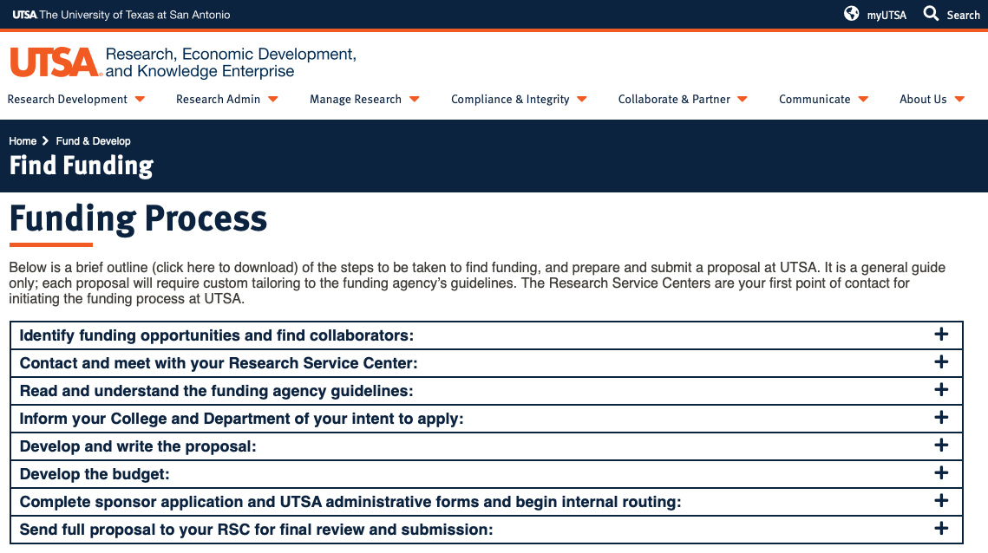
Funding your research
https://research.utsa.edu/fund-dev/find-funding/

Slide 33
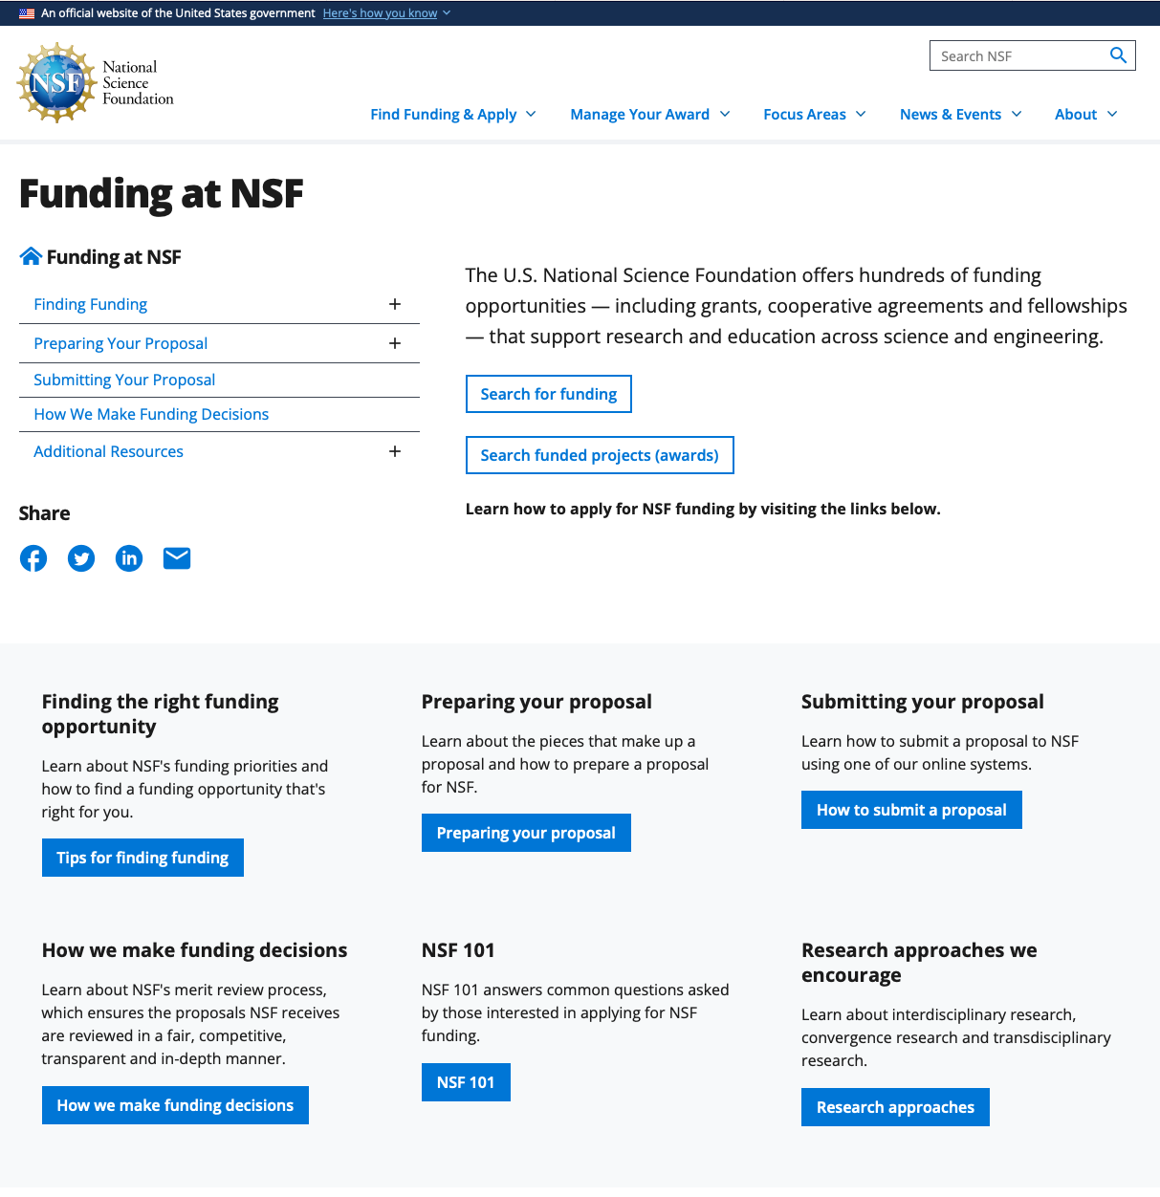
Funding your research
nsf.gov/funding

Slide 34
Wrap-Up
Tuesday
Formalize a research design for your project
To Do:
Guest Lecture Survey (in-class Thursday)
See you Thursday!

Slide 35
PS: something fun…
I asked an LLM to help me structure this lecture.
It gave me these :)

Slide 36
Guest Research Lecture #2:
Dr. Maryam Tabar
AI For Social Good
https://sciences.utsa.edu/faculty/profiles/tabar-maryam.html

Slide 37
Guest Research Lectures
Questions for experts in the field - ask them anything!
About their research..
What challenges did you face during this research, and how did you overcome them?
What are the real-world applications of your research?
What are the existing approaches to your research work?
About their research field..
What emerging trends do you see? What promising new areas?
What advice would you give to an undergraduate student interested in this research field?
What resources or communities can you recommend?
About careers & skills..
What skills do you find important in your field?
What was your career path?
How do you balance your research with other academic & personal commitments?

